Slide 1

RoBERTa: A Robustly Optimized BERT Pretraining Approach
Paper By
Yinhan Liu, Myle Ott, Naman Goyal, Jingfei Du et al., 2019
Presented By
Yash Aggarwal and Harsh Gunwant

Slide 2

1 Line Paper Summary
BERT is undertrained. We will fine-tune the original BERT and change input and pre-training settings to achieve state-of-the-art results
~ Authors of the paper
Notes:
There is a vast landscape of optimizations and ideas that were left out and this fact was acknowledged by the BERT authors.
What RoBERTa team did is build on these ideas and explore various optimizations for pre-training and fine-tuning

Slide 3

Index
Abstract
Introduction
Background
Experimental Setup
Training Procedure Analysis
RoBERTa
Related Work
Conclusion

Slide 4

Abstract
Language model pretraining has led to significant performance gains.
Several challenges when comparing these approaches
Computationally Expensive
Private Datasets
Hyperparameter Choices
BERT was significantly undertrained
Authors believe to match or exceed the performance after BERT (including GPT and GPT2)
Notes:
Point 1
The performance increase is due to overlooked design choices.

Slide 5
Introduction
Self-Training Models like BERT, BART, GPT are all the rage right now.
Large Model == Interpretability Issue
Language models go through 2 steps of training
Pre-training
Fine-Tuning
Authors believed BERT was undertrained and propose a new training method in the paper
Robustly optimized BERT approach or RoBERTa
Notes:
Point 2
Interpretability issue - Large model, can’t tell which part of model contribute to which result.

Slide 6
Introduction (2)
Modifications Suggested for RoBERTa
Training the model longer, with bigger batches, and more data
Removing the NSP objective
Training on longer Sequences
Using dynamic masking as a pre-training objective instead of static masking
Contributions of the paper
BERT Design Choices
Novel Dataset
Dynamic Masking as pre-training
Pre-trained and fine-tuned model
Notes:
BERT was trained for 1M steps and RoBERTa was trained for 500k steps. This may seem less but is a net increase due to the fact that batch size is increased.
Batch Size was changed from 256 examples to 2000 examples

Slide 7
Background
Setup
Architecture
Training Objectives
Dataset
Notes:
Setup - Bert takes 2 sentences as input
Architecture - BERT uses the transformer model but only the encoder part
Trained on Masked Language model and NSP
Dataset consists of Books Corpus and English wikipedia which is 16GB

Slide 8
Experimental Setup
BERT Implementation
BERT was implemented in FAIRSEQ with original architecture and hyperparameters
Changes were made to
Peak Learning Rate
Number of warm up steps
Adam Epsilon Term
β2 Term was changed from 0.999 to 0.98
Training is done with full length sequences unlike BERT that randomly injects short sequences.
Training is done on 8x32GB NVIDIA V100 GPUs

Slide 9
Experimental Setup (2)
Dataset Changes
Pre-training of large language models depend heavily on dataset.
Authors tried to create a new dataset that is combination of the following 5 datasets
BOOKCORPUS + English Wikipedia - 16GB
CC - News - 76GB
Open WebText - 38GB
STORIES - 31GB
Total ~160 GB
Notes:
Book Corpus is collection of over 12000 free books with word count greater than 20,000 words
English Wikipedia is the wikipedia dump of data in english language
CC-News is dataset of 63 million english NEWS articles between sept 2016 and feb 2019
Open Web Text - Urls crawled from reddit comments with >3 upvotes
STORIES - Common Crawl data filtered to match the Winograd Schema challenge

Slide 10
Experimental Setup (3)
Evaluation
After pre-training RoBERTa fine-tuning is same as that of BERT
The model is evaluated on following downstream tasks similar to BERT
GLUE
Collection of 9 datasets for single-sentence or sentence-pair classification
SQuAD
Answer question by extraction relevant span from context
RACE
28,000 passages with 100,000 questions.
Context is longer.
Notes:
GLUE - General Language Understanding Evaluation, Training and testing data is provided on submission server with leaderboards
SQUAD - Stanford Question Answering Dataset, has 2 versions, v1 where question will have and answer and v2 where question may not have an answer.
RACE - Reading Comprehension from Examinations, English comprehension passage exam in China. Longer context. MCQs

Slide 11
Training Procedure Analysis
Base Configuration
RoBERTa is trained by keeping the same configuration as BERT_{Base}
Number of Layers = 12
Embedding Dimensions = 768
Attention Heads = 12
Number of parameters = 110 Million

Slide 12
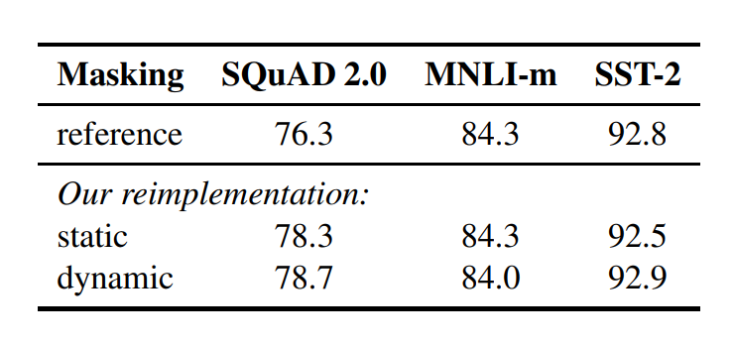
Training Procedure Analysis (2)
Static Vs Dynamic Masking

Slide 13
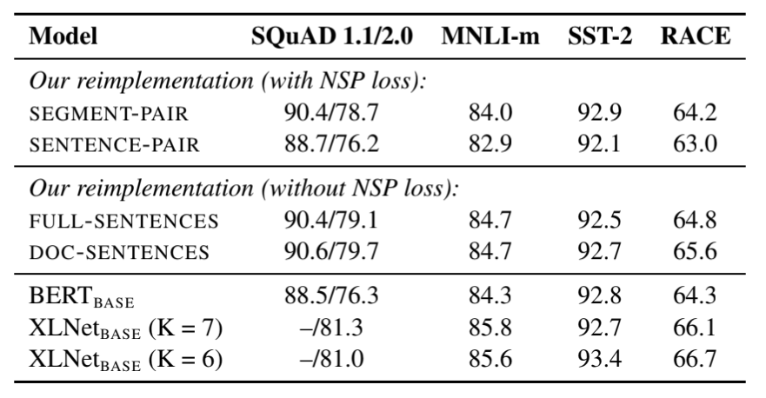
Training Procedure Analysis (3)
Model Input Format and NSP
Next Sentence Prediction Task in BERT and recent developments
SEGMENT - PAIR + NSP
SENTENCE - PAIR + NSP
FULL - SENTENCES
DOC - SENTENCES
Notes:
Next Sentence Prediction task is to give two sentences to the model in the form <cls> tokens <sep> tokens <end> and the objective is to predict if the second sentence is in continuation of the first sentence. This trains the model to get context information in longer sentences. However, the recent works have questioned the necessity of NSP loss. So the authors compare different scenarios.

Slide 14
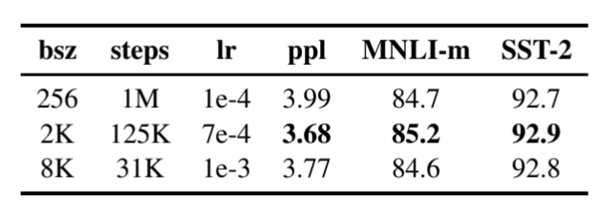
Training Procedure Analysis (4)
Training with larger batches
Past works have shown that NMTs trained on large mini-batches have better performance.
Same is the case with BERT
BERT was trained for 1M steps with batch size of 256
Authors try to find a sweet spot for different steps and batch sizes

Slide 15
Training Procedure Analysis (5)
Text Encoding
Character Level Byte Pair Encoding
BERT has a vocabulary of 30k
RoBERTa has a vocab of 50k words
Even though evidence suggests this is slightly worse, authors believe a standard encoding scheme is better than slight performance boosts.

Slide 16
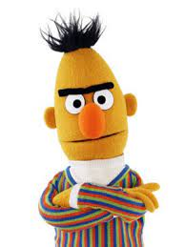
There is room for improvement in BERT !!

Slide 17

RoBERTa
Trained with dynamic masking
Full Sentences without NSP Loss
Large Mini- Batches
More Training Data (16Gb vs 160Gb)
Larger byte level BPE
Training the model Longer
Notes:
Dynamic masking instead of static masking, ie, over different iterations/epochs different tokens are masked.
Replacing NSP with Full sentences( without NLP loss )
BPE - Byte pair encoding
Bert was trained on 16Gb-BOOKCORPUS + English Wikipedia
Roberta was trained with additional data on CC - News, Open WebText,STORIES which accounts to 160 Gb. This paper additionally use a novel dataset, CC-NEWS
The model was trained on 1024 v100 GPUs(32GB) for approximately one day.

Slide 18
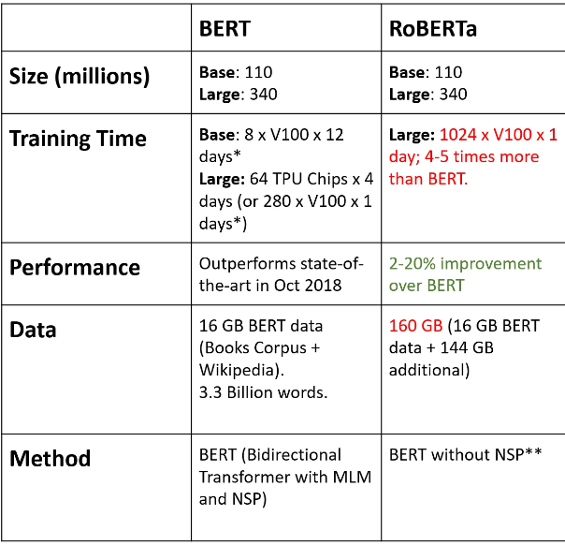
COMPARISON BETWEEN BERT AND RoBERTa
Notes:
Bert base has 12 transformer layers while RoBERTa has 24 layers.
PArameters are same in both but the pre training steps were increased from 200k to 500k.

Slide 19
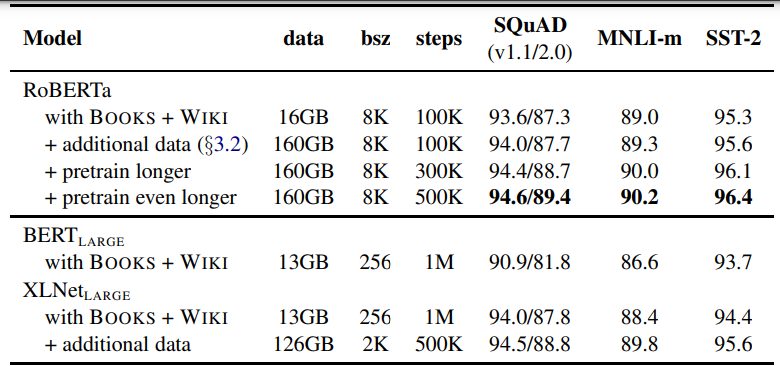
Development set results for RoBERTa
Notes:
XLNet was beating RoBERTa till RoBERTa was pre-trained for 500k steps.
But beats BERT.

Slide 20
GLUE
GLUE (General Language Understanding Evaluation) is a benchmark for evaluating the performance of natural language processing models on a diverse range of tasks.
The benchmark provides a suite of tasks that cover a broad range of linguistic phenomena and include tasks such as sentiment analysis, question answering, and text classification.
Two fine tuning settings are considered for GLUE - Single task,dev and ensembles, test
Notes:
RoBERTA was evaluated on three different benchmarks - GLUE, RACE and SQuAD.
GLUE - General Language Understanding Evaluation is a Collection of 9 datasets for single-sentence or sentence-pair classification.
GLUE has 9 different tasks including MNLI, QNLI etc.
In single task, dev RoBERTa is fine tuned separately for each GLUE tasks. Where a limited hyperparameter was considered for each task.
In ensembles, test they have compared RoBERTa on the test set via the GLUE leaderboard.

Slide 21
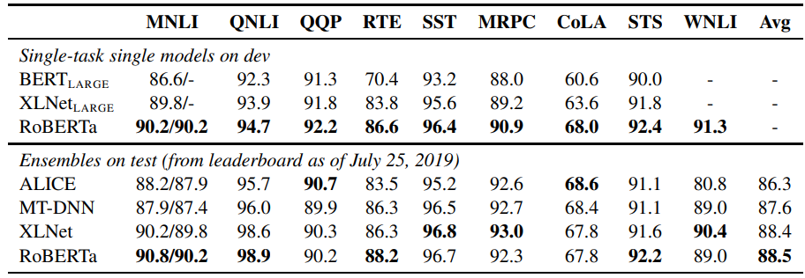
GLUE RESULTS
Notes:
The benchmark provides a suite of tasks that cover a broad range of linguistic phenomena and include tasks such as sentiment analysis, question answering, and text classification.
For RTE, STS and MRPC the authors found it helpful to finetune starting from the MNLI single-task model, rather than the baseline pretrained RoBERTa.
Out of these 9, Two of the GLUE tasks (QNLI and WNLI ) require task-specific finetuning approaches to achieve competitive leaderboard results.
Here , WNLI is blank because the authors found the provided NLI-format data to be challenging to work with. Instead they used the reformatted WNLI data from SuperGLUE
RoBERTa results on the development set are a median over five runs.
In ensemble we achieve state of the art in 4 out of 9 tasks.
The authors also expect that after incorporating more sophisticated multi-task finetuning procedures may further improve RoBERTa’s result.
It is clear that RoBERTa has outperformed the state of the art in almost all of the GLUE tasks including for ensemble models.
Crucially, RoBERTa uses the same masked language modeling pretraining objective and architecture as BERTLARGE, yet consistently outperforms both BERTLARGE and XLNetLARGE. This raises questions about the relative importance of model architecture and pretraining objective, compared to more details like dataset size and training time that is explored in this work.

Slide 22
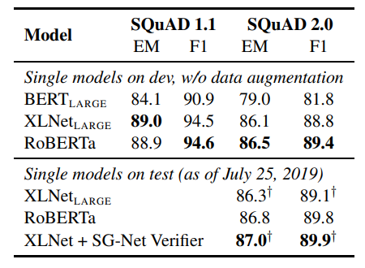
SQuAD RESULTS:
Notes:
SQUAD (Stanford Question Answering Dataset) is a benchmark for evaluating the performance of Natural Language Processing (NLP) models on the task of question-answering. The dataset consists of a large number of articles and corresponding questions, where the goal is for the model to predict the answer to each question based on the contents of the articles.
Here, SQUAD 1.1 and 2.0 are different versions. SQUAD 1.1 is the original version of the dataset, which consists of over 100,000 questions and answers derived from a set of Wikipedia articles.
SQUAD 2.0 is an updated version of the dataset, which includes a more diverse range of questions and answers,. For example, SQUAD 2.0 includes questions that are more open-ended and require more complex reasoning to answer, as well as questions that have multiple correct answers.
In particular, while both BERT and XLNet augment their training data with additional Qusestion Answer datasets, here RoBERTa is finetuned using the provided SQuAD training data.

Slide 23
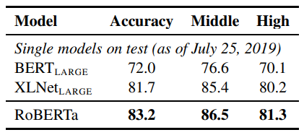
RACE RESULTS:
Notes:
For RACE, question-answer pairs that are longer than 128 tokens are truncated so that the total length is at most 512 tokens.
This is due to its large size and pre-training on a massive corpus of text, which has allowed it to learn a more robust and general representation of language.

Slide 24
CONCLUSION:
When pretraining BERT models, a number of design decisions were evaluated, and it was determined that BERT's performance can be significantly enhanced by training the model longer, with larger batches over more data; removing the next sentence prediction objective; training on longer sequences; and dynamically adjusting the masking.
RoBERTa achieves state-of-the-art results on GLUE, RACE, and SQuAD without the need for multi-task fine-tuning for GLUE or additional data for SQuAD.
These results demonstrate the significance of these formerly neglected design decisions and show that BERT's pretraining objective remains competitive in comparison to recently presented alternatives.

Slide 25
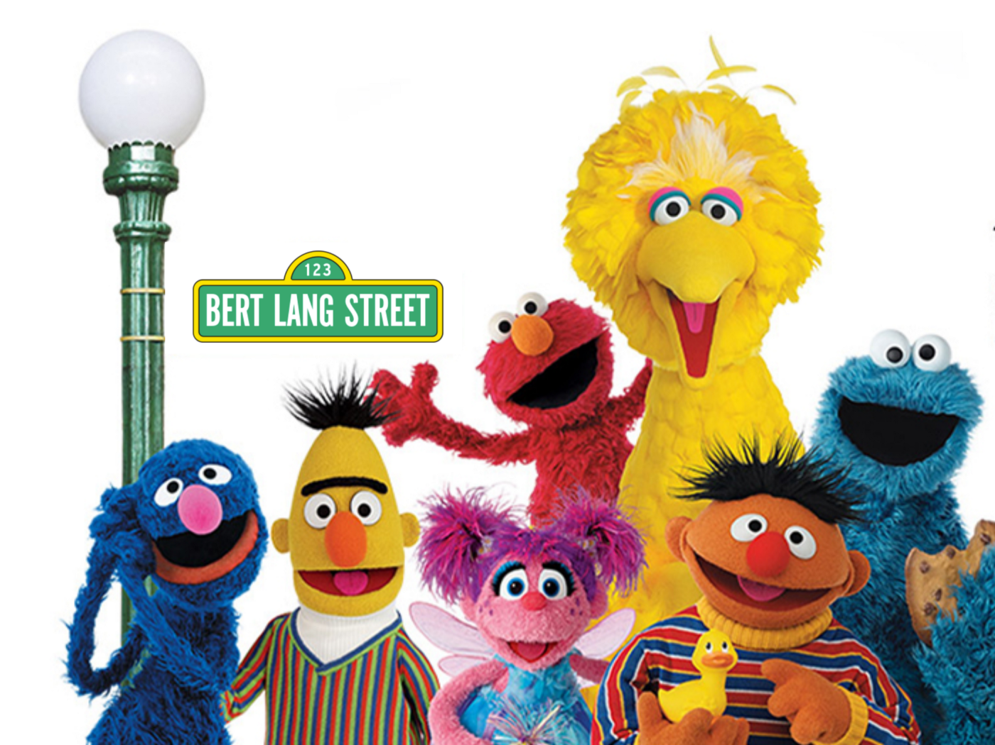
THANK YOU !!

